Slide 1

Partial F Test
Nina Gunnes
May 20, 2021

Slide 2
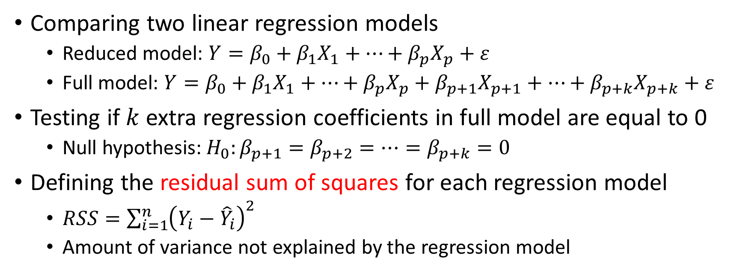
Partial F test
Comparing two linear regression models
  Reduced model: $Y=β_{0}+β_{1}X_{1}+⋯+β_{p}X_{p}+ε$
  Full model: $Y=β_{0}+β_{1}X_{1}+⋯+β_{p}X_{p}+β_{p+1}X_{p+1}+⋯+β_{p+k}X_{p+k}+ε$
Testing if $k$ extra regression coefficients in full model are equal to 0
  Null hypothesis: $H_{0}:β_{p+1}=β_{p+2}=…=β_{p+k}=0$
Defining the residual sum of squares for each regression model
  $RSS=\sum_{i=1}^{n}{{\left(Y_{i}−{\hat{Y}}_{i}\right)}^{2}}$
  Amount of variance not explained by the regression model

Slide 3
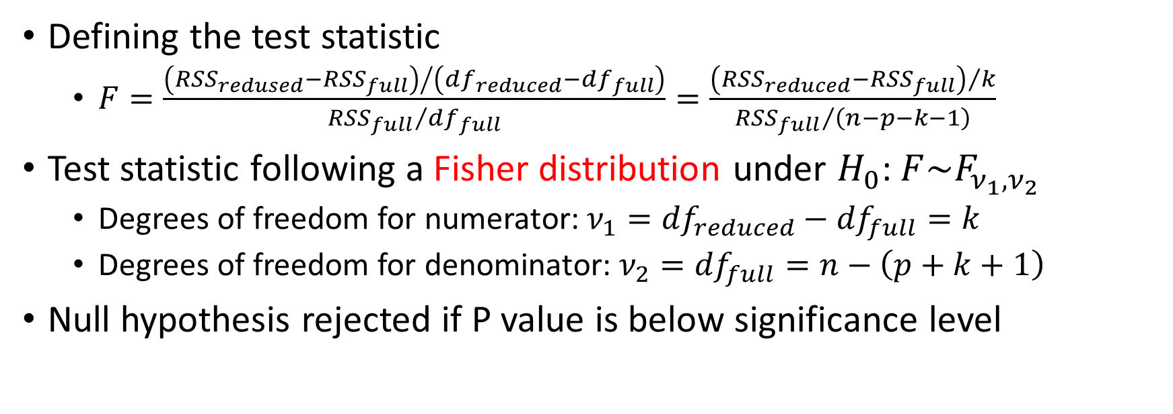
Partial F test, cont.
Defining the test statistic
  $F=\frac{{\left({RSS}_{redused}−{RSS}_{full}\right)}/{\left({df}_{reduced}−{df}_{full}\right)}}{{{RSS}_{full}}/{{df}_{full}}}=\frac{{\left({RSS}_{reduced}−{RSS}_{full}\right)}/k}{{{RSS}_{full}}/{\left(n−p−k−1\right)}}$
Test statistic following a Fisher distribution under $H_{0}$: $F\sim F_{ν_{1},ν_{2}}$
  Degrees of freedom for numerator: $ν_{1}={df}_{reduced}−{df}_{full}=k$
  Degrees of freedom for denominator: $ν_{2}={df}_{full}=n−\left(p+k+1\right)$
Null hypothesis rejected if P value is below significance level

Slide 4
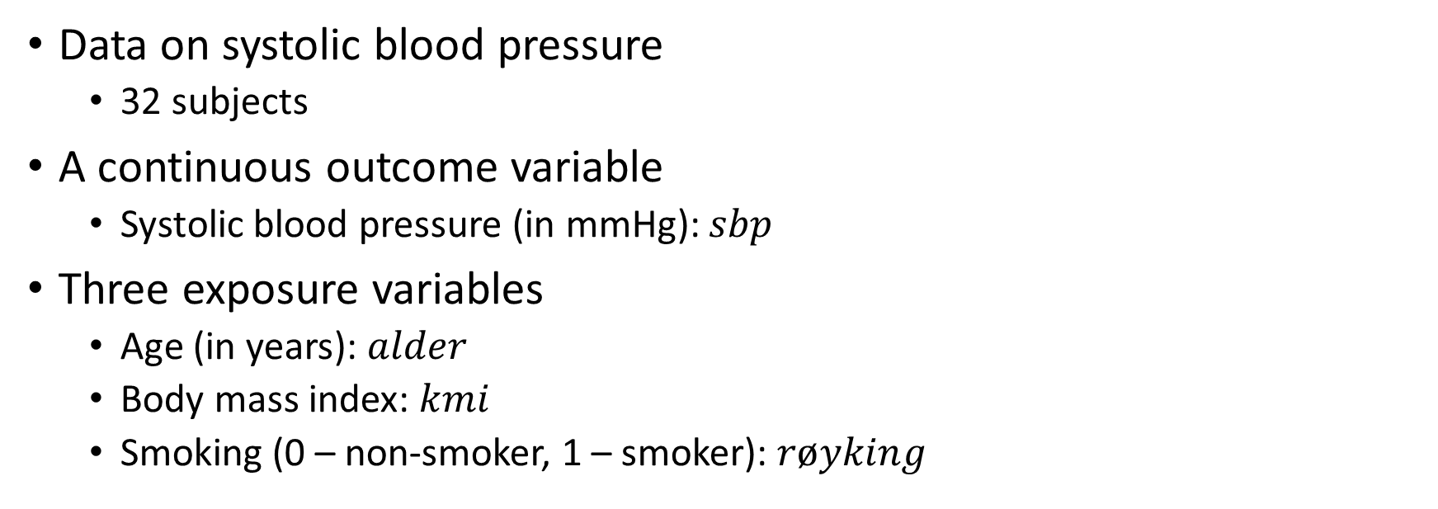
Example 3.11 in Laake et al. (2007)
Data on systolic blood pressure
  32 subjects
A continuous outcome variable
  Systolic blood pressure (in mmHg): $sbp$
Three exposure variables
  Age (in years): $alder$
  Body mass index: $kmi$
  Smoking (0 – non-smoker, 1 – smoker): $røyking$

Slide 5
Example 3.11 in Laake et al. (2007), cont.
Described in Chapter 3 in the book by Laake et al. (2007)
Data and variable description available for download
  https://www.med.uio.no/imb/personer/vit/veierod/boker/epidemiologiske-og-kliniske-forskningsmetoder/datafiler/

Slide 6
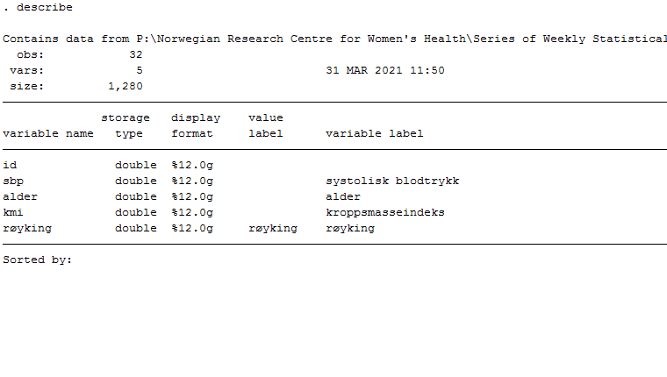
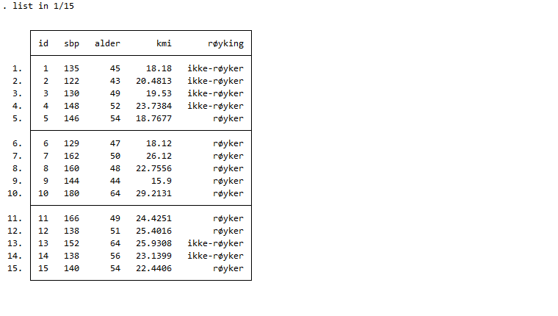
How to do it in Stata

Slide 7
How to do it in Stata, cont.
Not necessarily a linear effect of body mass index
Categorizing body mass index as by its quartiles
  Category 1: first quartile
  Category 2: second quartile
  Category 3: third quartile
  Category 4: fourth quartile
Defining dummy variables for each category
  First category as the reference

Slide 8
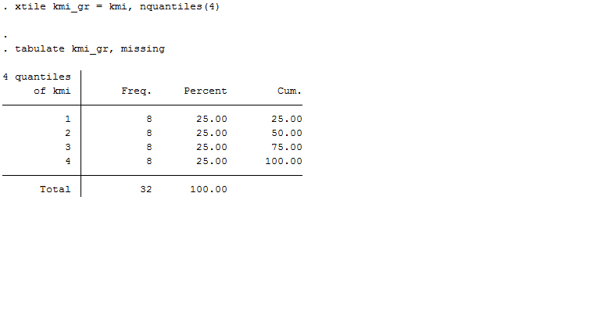
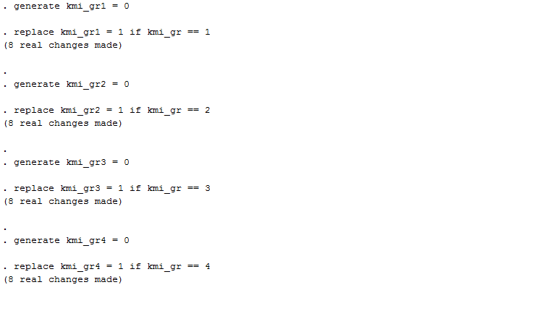
How to do it in Stata, cont.

Slide 9
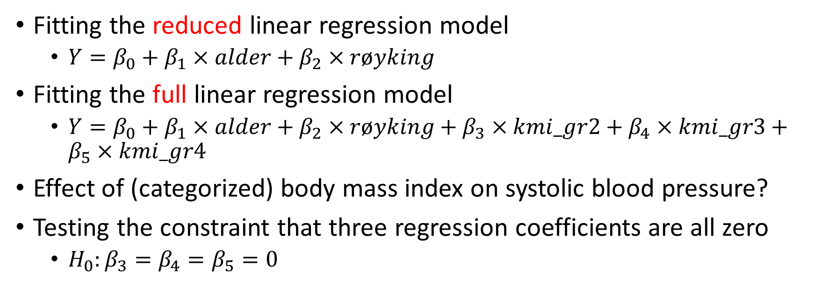
How to do it in Stata, cont.
Fitting the reduced linear regression model
  $Y=β_{0}+β_{1}×alder+β_{2}×røyking$
Fitting the full linear regression model
  $Y=β_{0}+β_{1}×alder+β_{2}×røyking+β_{3}×kmi_gr2+β_{4}×kmi_gr3+β_{5}×kmi_gr4$
Effect of (categorized) body mass index on systolic blood pressure?
Testing the constraint that three regression coefficients are all zero
  $H_{0}:β_{3}=β_{4}=β_{5}=0$

Slide 10
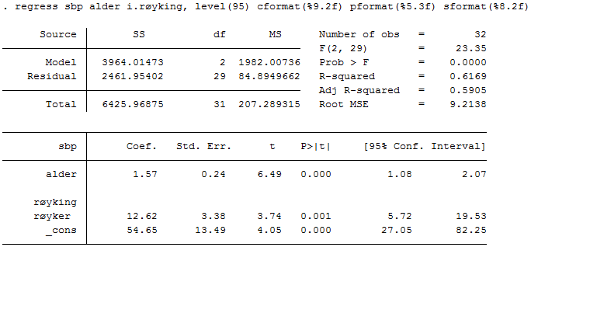
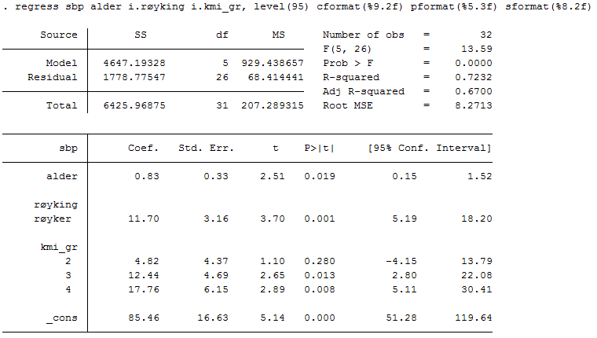
How to do it in Stata, cont.
Reduced model
Full model

Slide 11
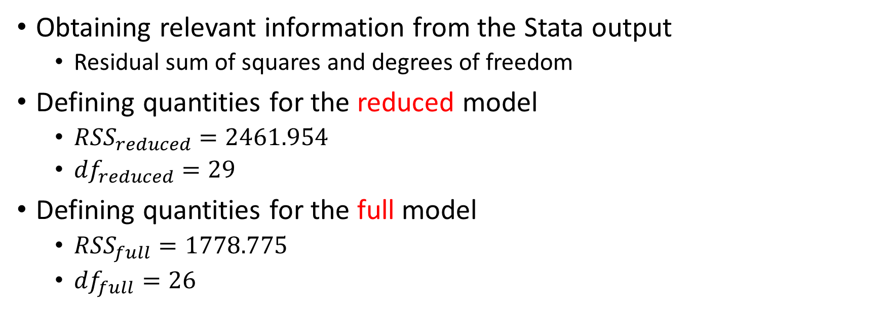
How to do it in Stata, cont.
Obtaining relevant information from the Stata output
  Residual sum of squares and degrees of freedom
Defining quantities for the reduced model
  ${RSS}_{reduced}=2461.954$
  ${df}_{reduced}=29$
Defining quantities for the full model
  ${RSS}_{full}=1778.775$
  ${df}_{full}=26$

Slide 12
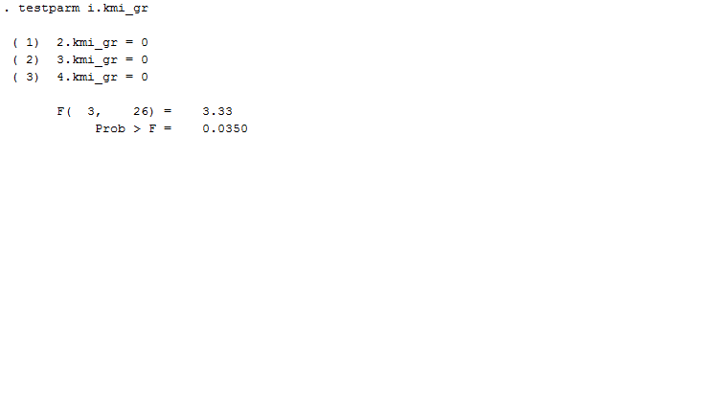
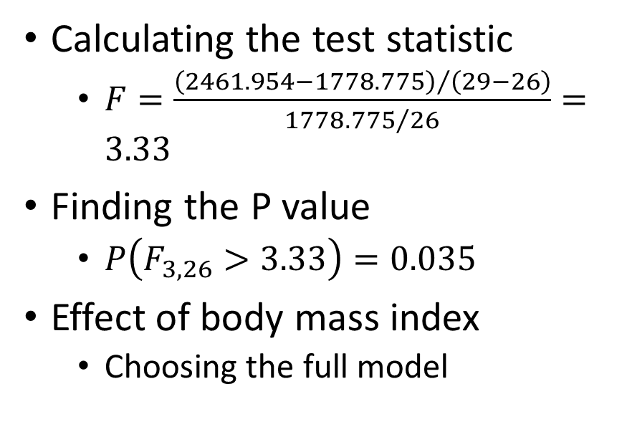
How to do it in Stata, cont.
Calculating the test statistic
  $F=\frac{{\left(2461.954−1778.775\right)}/{\left(29−26\right)}}{{1778.775}/{26}}=3.33$
Finding the P value
  $P\left(F_{3,26}>3.33\right)=0.035$
Effect of body mass index
  Choosing the full model

Slide 13
References
Goldstein H. Introduction to F-testing in linear regression models. Lecture notes. November 2015. Accessed May 19, 2021. https://www.uio.no/studier/emner/sv/oekonomi/ECON4130/h15/lecture-note-on-f-test-2015.pdf.
Laake P, Hjartåker A, Thelle DS, Veierød MB. Epidemiologiske og kliniske forskningsmetoder. Oslo: Gyldendal akademisk; 2007. https://www.med.uio.no/imb/forskning/publikasjoner/boker/2007/epidemiolgiske-kliniske-forskningsmetoder.html.
StataCorp. 2017. Stata 15 Base Reference Manual. College Station, TX: Stata Press.

